Slide 1


Slide 2

WOMAN’S MONTH OF SOUTH AFRICANS
DMRE:
INEP Leaners Focus Week
CD: Mr Khorommbi Bongwe
Date: August 2016

Slide 3
BACKGROUND
INEP directorate produced 198 technicians and artisan through its electrical engineering programme (from 2007/8 – 2008/9 financial year) – R10 million was spent on stipend.
The training programme was aimed to support ASGISA, JIPSA, municipality capacity programme, poverty alleviation and job creation as South Africa identified as the country that have a severe shortage of skills.
100% of the trained students were absorbed by different entities (e.g. Eskom, municipalities, consulting companies, etc)
The programme was stopped in 2009 due to a lack of funds, as it was funded under Departmental savings.

Slide 4
Challenges and Mitigation
As the programme was stopped due to a lack of funds, the Directorate (INEP) submitted a business proposal for funding to EWSETA in April 2011
EWSETA approves an amount of R 3 million that will only cater for stipend for a period of 18months.
The steering team was also established to monitor and evaluate the success of the programme, and the team is represented by (INEP (K Bongwe), DoE Human Resource and EWSETA)
The successful candidates will be deployed to various metro municipalities for training purposes.

Slide 5
OPPORTUNITIES AFTER COMPLETIONS
Consulting
      Electrical projects
      Mechanical projects
      Designs of electrical network
      Technical Audit and Evaluation
Contracting
      Construction
      Electrification
      Wiring
      Service Connections
      Transportation of Materials
      Maintenance

Slide 6
OPPORTUNITIES AFTER COMPLETIONS
Suppliers
      Poles
      Protection equipment
      Metering and accessories
      Conductors
      Transformers
      Cables
      Switchgears
      Streets lights
      Other Electrical Apparatus

Slide 7
Student Training Programme

Slide 8
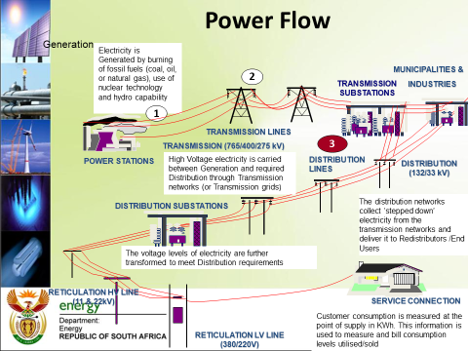
Student Training Programme

Slide 9
ENGINEERING – DESIGN & DEVELOPMENT
Planning and cost estimation of service connections
Managing and control of service connections
Design, planning and cost estimate of network systems
Managing and control of planning service
Supervising and taking responsibility for project, or part of a project

Slide 10
ENGINEERING – ENERGY AND NETWORK CONTROL
Overall knowledge of operating system
Power distribution concepts- 133/33/ 11 kV & 132/11 kV networks, ring feeds & control methods.
Switching methods, procedures & permits
Control room operation, handling complaints, and communication with workforce.

Slide 11
CORPORATE SERVICES – HR DEVELOPMENT
Induction Phase 3
Safety signs and colour code
Identification of conductors, cables and knowledge of current carrying capacity
Connecting methods of conductors
Making 16mm x 4 core PVC cable termination
Knowledge of basic panel wiring methods
Knowledge of electrical components (consumer and streetlight control)
Make a 11kV XLPE cable termination

Slide 12
ENGINEERING – LOW & HIGH VOLTAGE
Maintenance of LV, MV & HV systems
Construction and maintaining LV, MV and HV distribution systems
Supervising and taking responsibility for project, or part of a project
Maintenance and construction of streetlight systems

Slide 13
RETAIL - METERING
Installing and wiring of meters
Meter complaints
Managing and control of metering service

Slide 14
ENGINEERING – NETWORK OPTIMIZATION
Transformers
Protection/SCADA
Testing

Slide 15
RETAIL – REVENUE PROTECTION
Test and calibrate energy meters
Connecting and maintaining consumer services
Ordering equipment and material, arrange with-off for change-overs, connections, testing and finishing off.

Slide 16
RETAIL – SALES SYSTEM
Use of test instruments and basic repairs
Telemetry and computer systems
Two-way radio communication system
Vending equipment and service

Slide 17
ENGINEERING – TRANSMISSION
Medium & High voltage switches
Maintenance of LV, MV & HV systems
Construction and maintaining LV, MV and HV distribution systems
Supervising and taking responsibility for project, or part of a project

Slide 18
CONCLUSION
DOE will contribute towards the development of conditions that will encourage Black Economic Empowerment and the participation of SMMEs in the Electricity Sector.
Contribute to the government’s initiative on accelerated and shared growth initiative of South Africa(Asgisa) through INEP electrical engineering training programme.
The challenges of funding can be addressed by introducing training programme budget within the INEP operational budget (e.g. Our CFO approve the proposal)

Slide 19

THANK YOU

